Slide 1


CAPSTONE PROJECT

Slide 2
Personal Background
Name : Chamarthi Anil Kumar Raju
Qualification: B.Tech
Branch: CSE
Experience: Fresher

Slide 3
Problem statement of the capstone project
Manual testing of the NOPCommerce demo e-commerce site takes a lot of time, involves repeating the same steps, and can easily lead to mistakes, especially because the site is updated frequently. Important actions like user registration, logging in, searching for products, adding items to the cart, and checking out need to be tested on different browsers many times.
This project aims to automate these key tasks using Java, Selenium WebDriver, and TestNG. Automation helps tests run faster, reduces errors, supports testing on multiple browsers, and provides clear reports with screenshots when something goes wrong.
Some of the challenges faced include handling elements on the website that change or load at different speeds, making sure tests work well on various browsers, managing different sets of test data, and creating detailed reports that are easy to understand.

Slide 4
Mannual Testing for nop commerce website

Slide 5
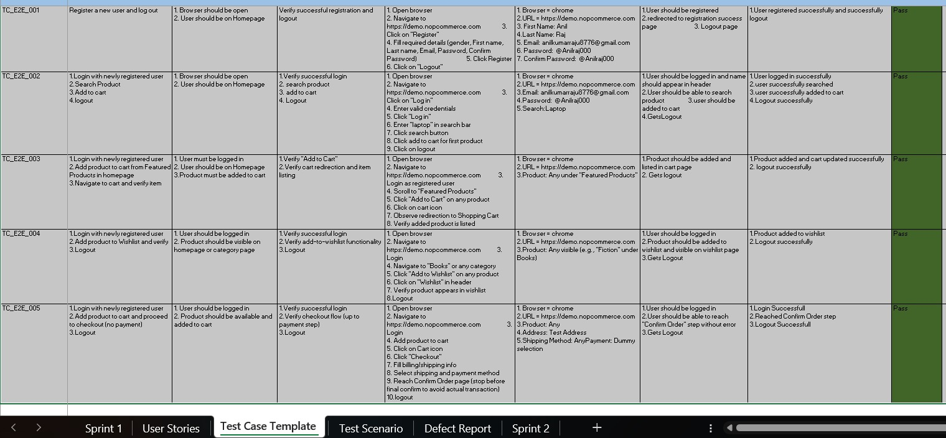
Manual Test Cases for End To End Test Cases

Slide 6
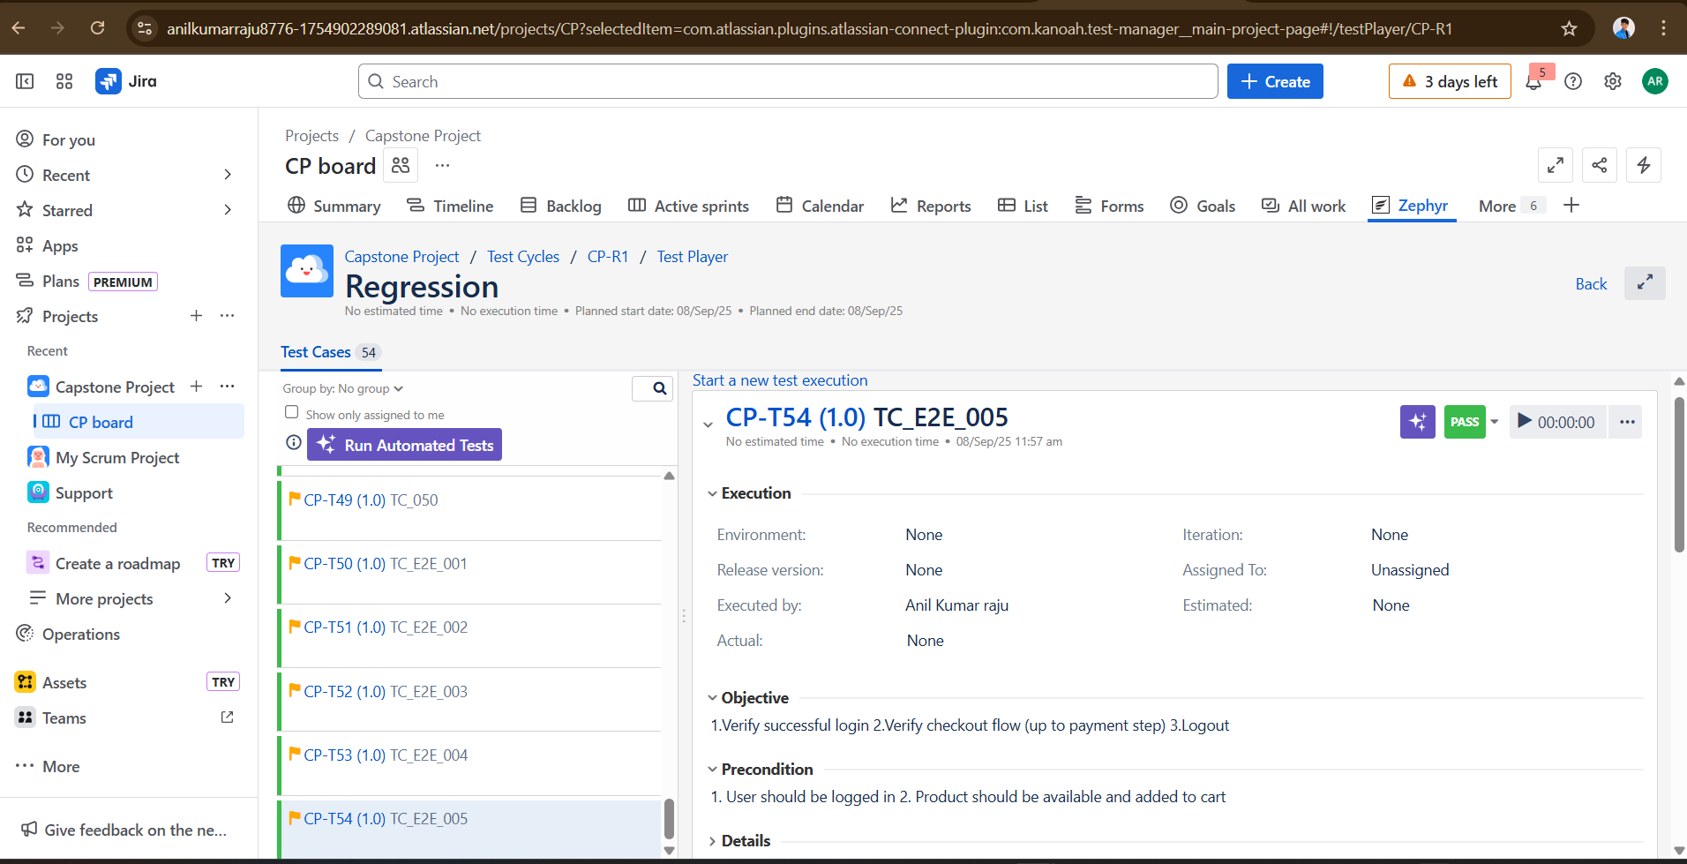

Slide 7
Automation Testing for nop commerce website

Slide 8
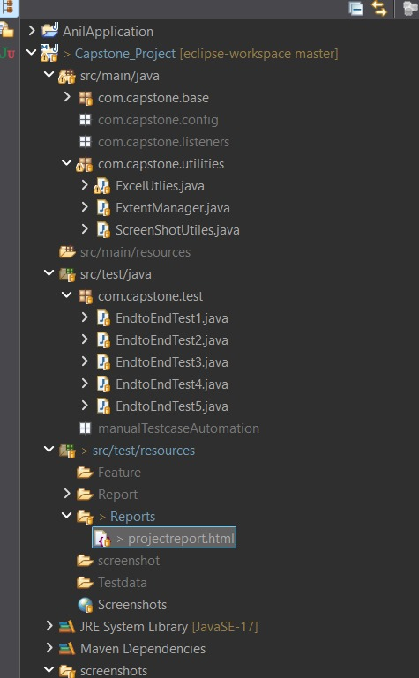
Capstone Project Structure

Slide 9
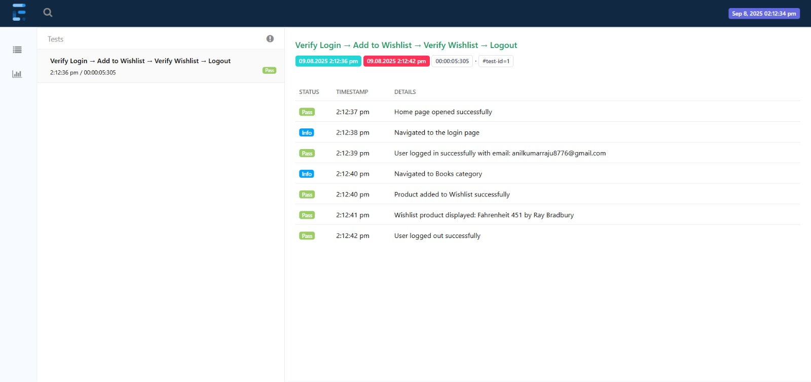
Test Case 1

Slide 10
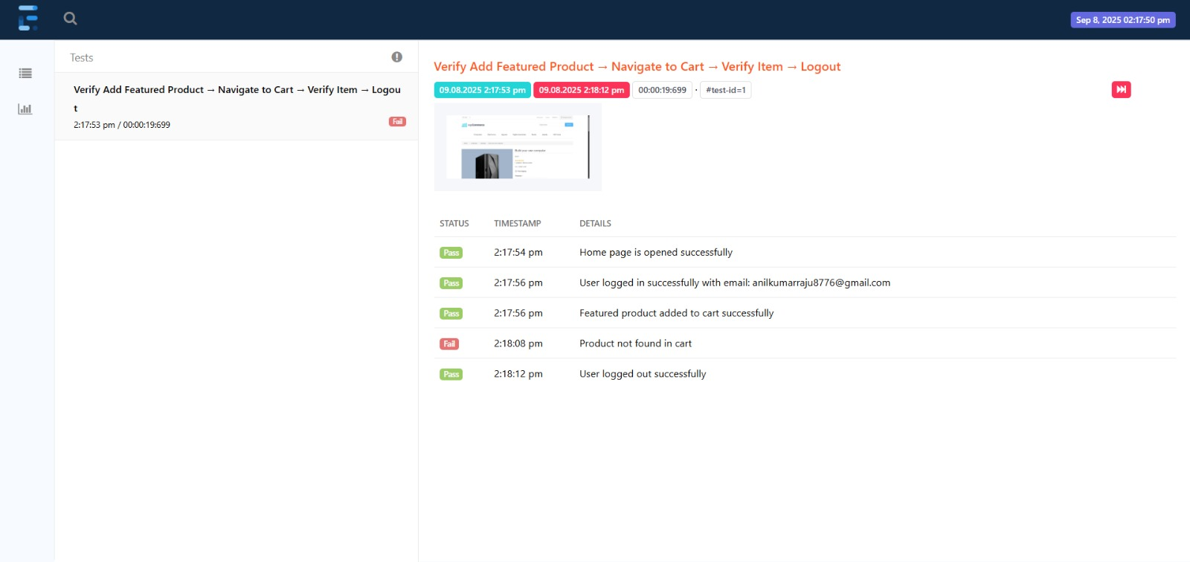
Test Case 2

Slide 11
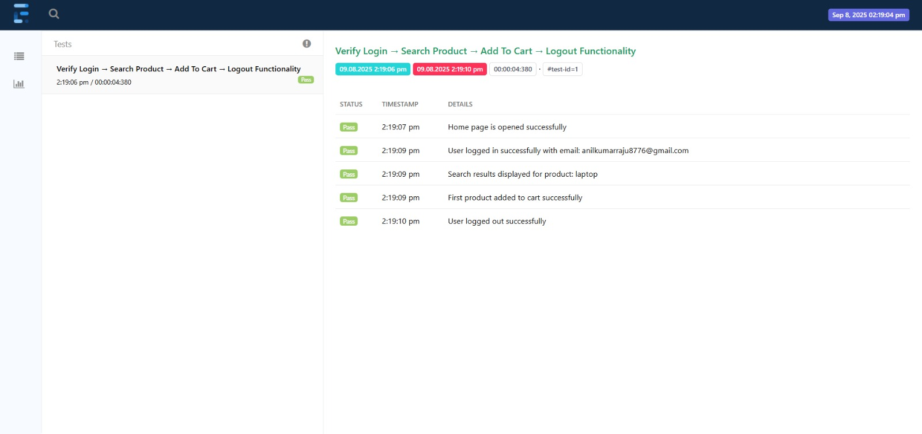
Test Case 3

Slide 12
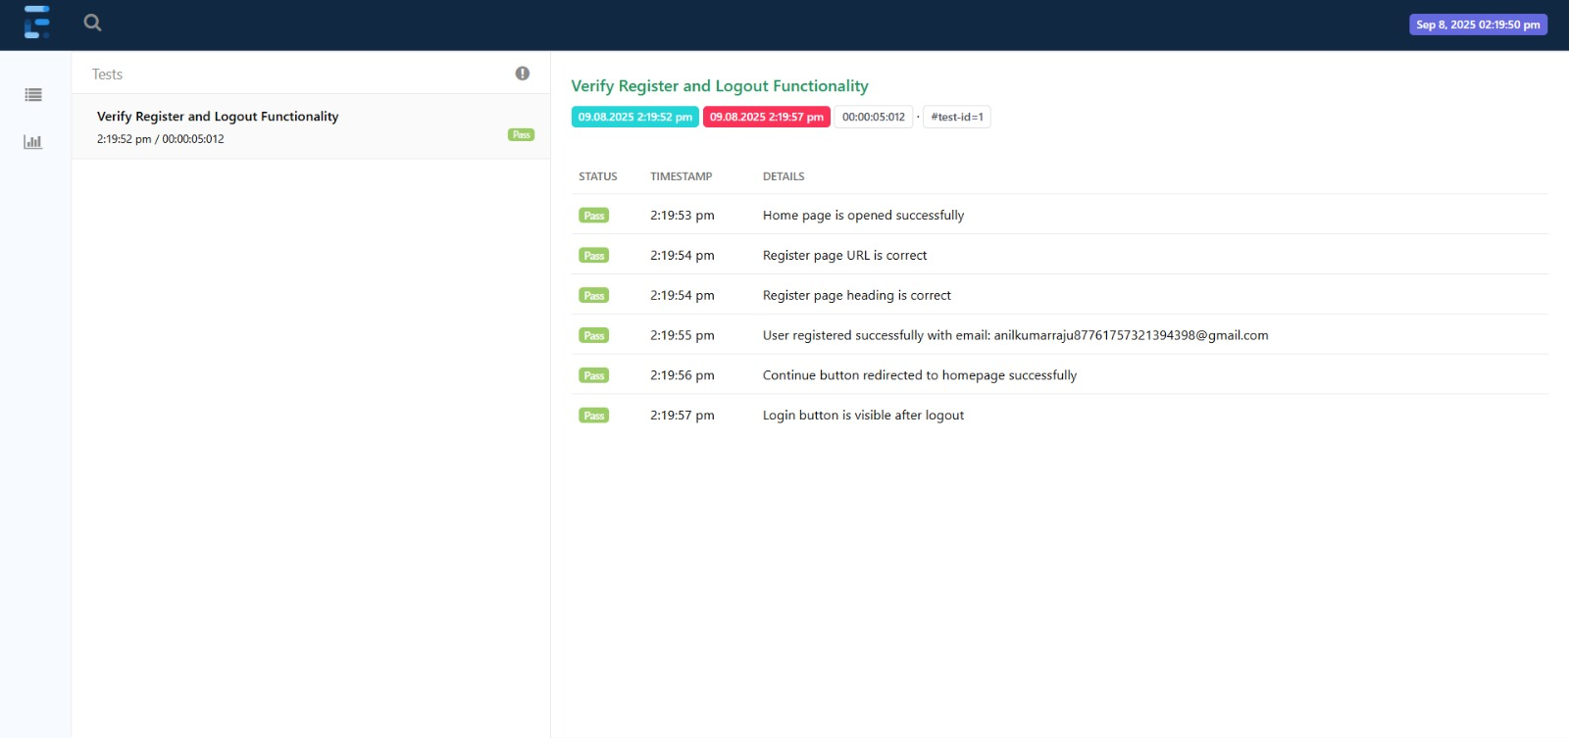
Test Case 4

Slide 13
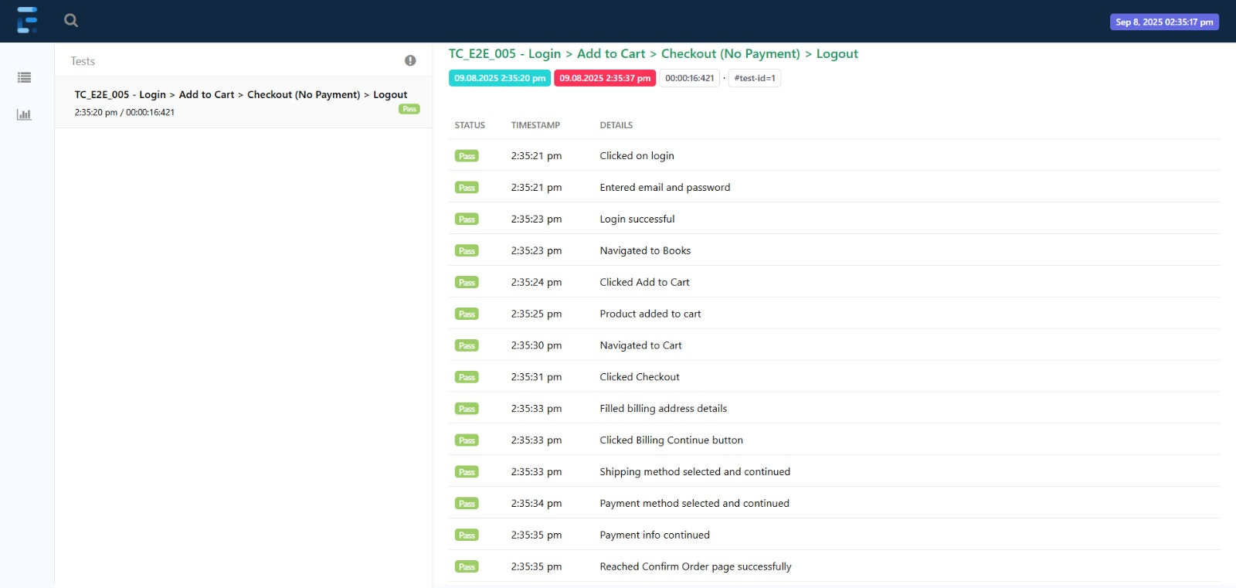
Test Case 5

Slide 14
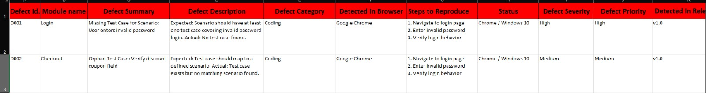
Defect REPORTS

Slide 15
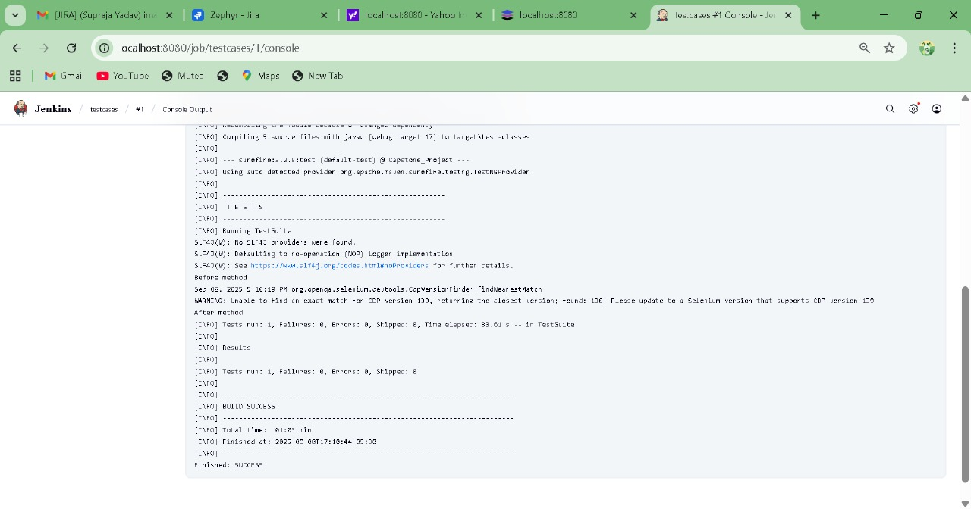
Jenkins Report

Slide 16
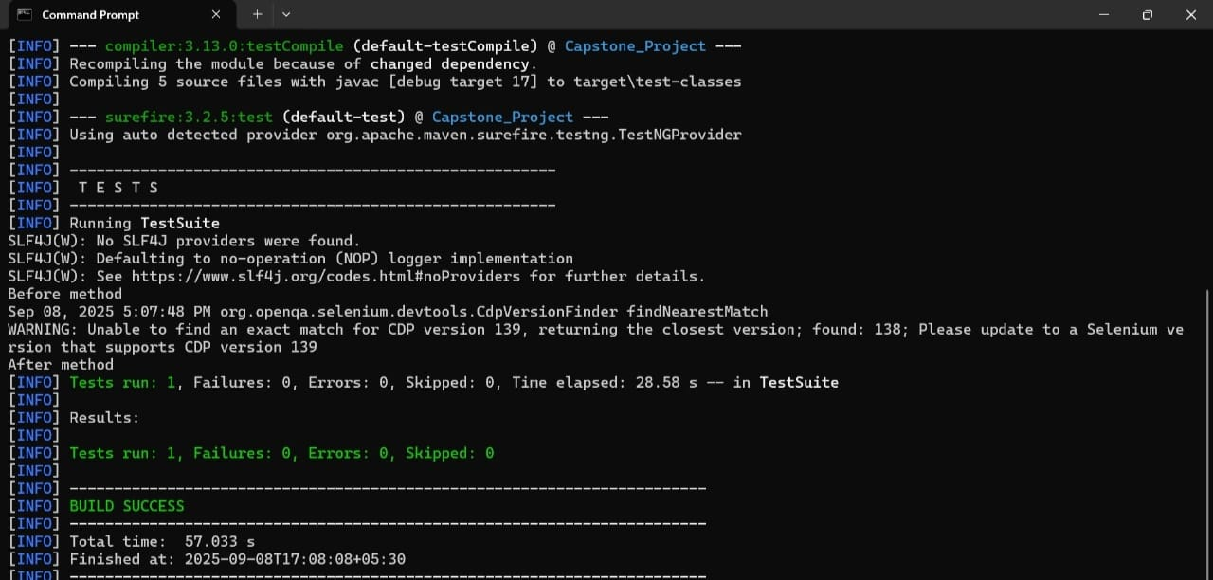

Slide 17
Conclusion
The automation of the NOPCommerce demo website using Selenium WebDriver and TestNG has significantly enhanced the testing process by improving efficiency, accuracy, and scalability. The structured test management and detailed reporting enabled early issue detection, while the comprehensive test coverage ensured consistent functionality across multiple browsers. The framework’s scalability and data-driven approach facilitated easy expansion and reliable testing outcomes. Overall, this automation solution reduced testing time, maintained high-quality standards, and provided continuous validation, supporting the website’s ongoing development and evolution.

Slide 18
GIT URL
https://github.com/anilraj000/Capstone_Project/tree/master/Capstone_Project

Slide 19
Thank You

